Slide 1


Data Analytics Tools and Techniques
ASSIGNMENT TWO (2021/2022) SESSION
Oluwafemi Emmanuel Zachariah c1034108

Slide 2
INTRODUCTION
Pension Funds Accountant Research Group (PFARG) seek to investigate the administrative cost of pension funds and relate these costs to measures of the size, turnover and administrative complexity of the funds.
The datasets were gotten from responses of pension funds managers from the questionnaire circulated in the preceding financial year. Critical scrutiny has been made on the dataset to remove unnecessary variables as well as missing variables. Henceforth, only forty-five (45) observations will be considered for this analysis.

Slide 3
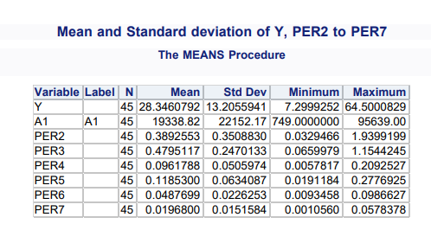
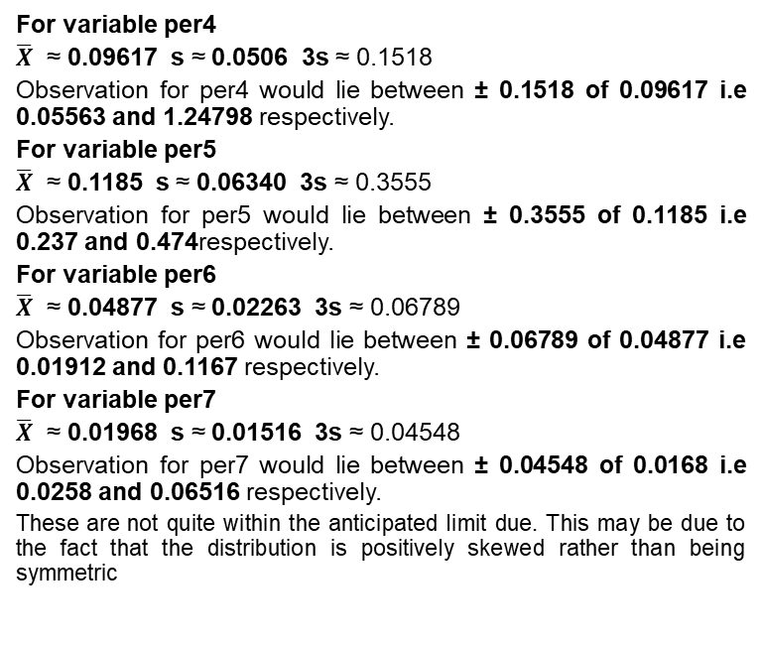
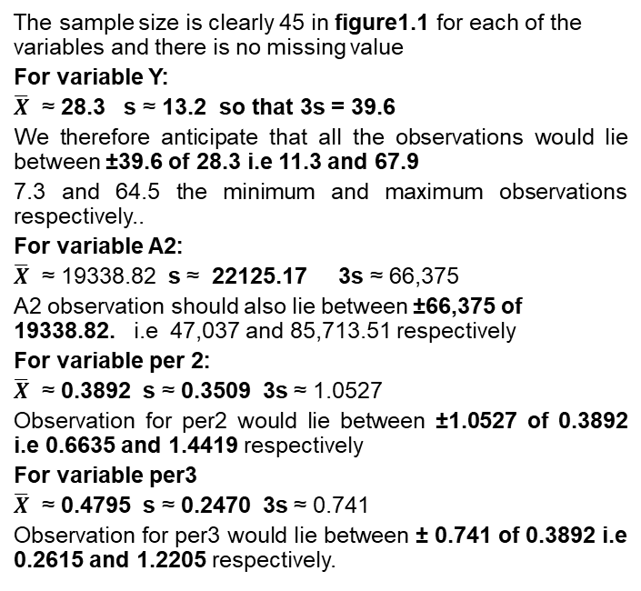
FIGURE 1.1: MEAN AND STANDARD DEVIATION OF Y, A1, PER2 TO PER7
The sample size is clearly 45 in figure1.1 for each of the variables and there is no missing value
For variable Y:
$\overline{X}$ ≈ 28.3 s ≈ 13.2 so that 3s = 39.6
We therefore anticipate that all the observations would lie between ±39.6 of 28.3 i.e 11.3 and 67.9
7.3 and 64.5 the minimum and maximum observations respectively..
For variable A2:
$\overline{X}$ ≈ 19338.82 s ≈ 22125.17 3s ≈ 66,375
A2 observation should also lie between ±66,375 of 19338.82. i.e 47,037 and 85,713.51 respectively
For variable per 2:
$\overline{X}$ ≈ 0.3892 s ≈ 0.3509 3s ≈ 1.0527
Observation for per2 would lie between ±1.0527 of 0.3892 i.e 0.6635 and 1.4419 respectively
For variable per3
$\overline{X}$ ≈ 0.4795 s ≈ 0.2470 3s ≈ 0.741
Observation for per3 would lie between ± 0.741 of 0.3892 i.e 0.2615 and 1.2205 respectively.
For variable per4
$\overline{X}$ ≈ 0.09617 s ≈ 0.0506 3s ≈ 0.1518
Observation for per4 would lie between ± 0.1518 of 0.09617 i.e 0.05563 and 1.24798 respectively.
For variable per5
$\overline{X}$ ≈ 0.1185 s ≈ 0.06340 3s ≈ 0.3555
Observation for per5 would lie between ± 0.3555 of 0.1185 i.e 0.237 and 0.474respectively.
For variable per6
$\overline{X}$ ≈ 0.04877 s ≈ 0.02263 3s ≈ 0.06789
Observation for per6 would lie between ± 0.06789 of 0.04877 i.e 0.01912 and 0.1167 respectively.
For variable per7
$\overline{X}$ ≈ 0.01968 s ≈ 0.01516 3s ≈ 0.04548
Observation for per7 would lie between ± 0.04548 of 0.0168 i.e 0.0258 and 0.06516 respectively.
These are not quite within the anticipated limit due. This may be due to the fact that the distribution is positively skewed rather than being symmetric

Slide 4
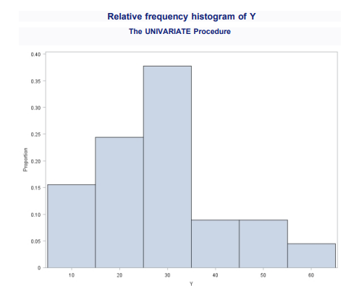
Figure1.2: Histogram for the response variable Y
From figure 1.2 above, it can be seen that this distribution is positively skewed and it is unimodal. The total cost per active member is common in the region of 15 to 35 pounds and only proportion of about 0.2 ( one-fifth) of sampled total cost per active members are lesser whilst higher cost, although less common can be as high as 60 pounds per active member.

Slide 5
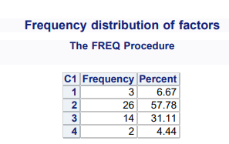
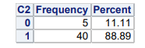
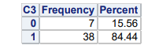
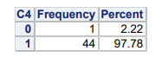
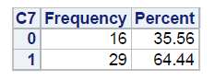
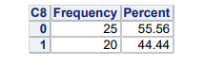
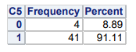
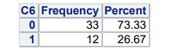
FIGURE 1.3: SIMPLE FREQUENCY DISTRIBUTION FOR FACTORS C1 TO C8
FIGURE 1.3A
FIGURE 1.3C
FIGURE 1.3D
FIGURE 1.3B
FIGURE 1.3G
FIGURE 1.3H
FIGURE 1.3E
FIGURE 1.3F
Figure 1.3A shows that sample percentage of fund type (c1) of each of the observation. It can be seen that 3 (6.67%) are staff only, 26 (57.78%) are combined scheme and same scale, 14 (31.11%) are separate scheme while 2 ( 4.44%) are for combined scheme different scale.
Figure 1.3B shows that 5 (11.11%) of the disagreed that the scheme should be contracted out while 40(88.89%) have a contrary opinion.
It can be seen from figure 1.3C that 7(15.56%) disagreed that the scheme is contributory whilst 38 (84.44%) are of the view that scheme is contributory.
Figure 1.3D shows that only 1(2.22%) of the respondent disagreed whether members can pay AVC's while 44(97.78%) agreed that members can pay additional voluntary contributions.
Figure 1.3E shows that 4 (8.89%) disagreed whether all administration is based at one location whilst 41(91.11%) agreed.
In table 1.3F 33(73%) disagreed that all administrative calculations are performed on one IT platform and 12(26.67%) agreed.
Figure 1.3G shows that 16(35.56%) insisted that special communications are not sent to members at the year-end while 29(64.44%) agreed.
Figure 1.3H show that 25(55.56%) are of the opinion that rule changes are not communicated directly to members whilst 20(44.44%) do accept.
C4 should not be included in any regression Y because the variability is high.

Slide 6
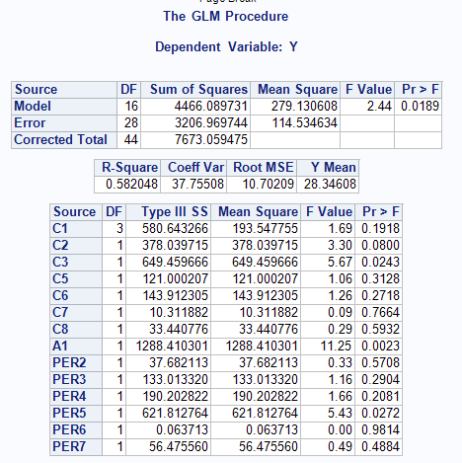
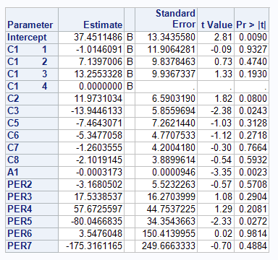
FIGURE 2.1: FITTING A MULTIPLE REGRESSION MODEL OF Y ON A1, PER2 TO PER7, C1 TO C3, AND C5 TO C8 ­
In the presence of C2, C3, C5, C6, C7,C8, A1, Per2 to Per7, the partial regression coefficient of C1 (Fund type) is estimated to have mean square with an associated two-tailed p-value of p₀ = 0.1918. Since p₀ > 0.05, the corresponding t-statistics is not significant. In the current regression model (in the presence C2, C3, C5, C6, C7, A1, Per2 to Per7 ) we have no significant evidence that the explanatory variable C1(fund type) contributes to the description the response variable Y (total cost per active member).
In the presence of C1, C3, C5, C6, C7, C8, A1, Per2 to Per7, the partial regression coefficient of C2 (whether the scheme is contracted out), it is estimated to have 11.9731 with an associated two tailed p-value of p₀ = 0.08. since p₀ > 0.05, the corresponding t-statistics is not significant. We have no significant evidence that the explanatory variable C2 (whether the scheme is contracted out) contributes to the description the reponse variable Y (total cost per active member).

Slide 7
In the presence of C1, C2, C3, C6, C7, C8, A1, per2 to per7, the partial regression coefficient of C5 (Whether all administration is based at one location), it is the estimated to have -7.4643 with an associated two tailed p-value of p₀ = 0.3128 . since p₀ > 0.05 . the corresponding t stat is not significant
In the presence of C1, C2, C3, C5, C7, C8, A1, per2 to per7, the partial regression coefficient of C6 (Whether all administrative calculations are performed on one IT platform). It is estimated to have -5.3477 with an associated two tailed p-value of p₀ = 0.2718. since p₀ > 0.05 . the corresponding t stat is not significant
In the presence of C1, C2, C3, C6, C5, C8, A1, per2 to per7, the partial regression coefficient of C7 (Whether special communications are sent to members at the year end). It is estimated to have -1.2603 with an associated two tailed p-value of p₀ = 0.7664. since p₀ > 0.05 . the corresponding t stat is not significant
In the presence of C1, C2, C3, C6, C5, C7, A1, per2 to per7, the partial regression coefficient of C8 (Whether rule changes are communicated directly to members). It is estimated to have -2.1 with an associated two tailed p-value of p₀ = 0.5932. since p₀ > 0.05 . the corresponding t stat is not significant
In the presence of C1, C2, C3, C6, C5, C7, A1, per3 to per7, the partial regression coefficient of per2 (number of deferred pensioners per active member). It is estimated to have -3.16 with an associated two tailed p-value of p₀ = 0.5708. since p₀ > 0.05 . the corresponding t stat is not significant.
In the presence of C1, C2, C3, C6, C5, C7, A1, per2, per4 per5,per6 and per7, the partial regression coefficient of per3 (number of pensioners per active member). It is estimated to have 17.53 with an associated two tailed p-value of p₀ = 0.2904. since p₀ > 0.05 . the corresponding t stat is not significant
In the presence of C1, C2, C3, C6, C5, C7, A1, per2, per3 per5,per6 and per7, the partial regression coefficient of per4 (number of starters in current year per active member It is estimated to have 57.67 with an associated two tailed p-value of p₀ = 0.2081. since p₀ > 0.05 . the corresponding t stat is not significant
In the presence of C1, C2, C3, C6, C5, C7, A1, per2, per3 per4,per5 and per7, the partial regression coefficient of per6 (number of new pensioners in current year per active member ) It is estimated to have 3.5676 with an associated two tailed p-value of p₀ = 0.9814 since p₀ > 0.05 . the corresponding t stat is not significant
In the presence of C1, C2, C3, C6, C5, C7, A1, per2, per3 per4,per5 and per7, the partial regression coefficient of per7 (number of cessations in current year per active member ) It is estimated to have -175.3161 with an associated two tailed p-value of p₀ = 0.4884 since p₀ > 0.05 . the corresponding t stat is not significant
However in the presence of other variables, C3,A1 and Per5 has p₀ value of 0.0234, 0.0023 and 0.0272 respectively, since p₀ < 0.05 in the three variables, the corresponding t statistics at 5% level (two tailed) is significant. We can have evidence that variable C3,A1 and Per5 contribute to the current regression model of Y and they should be included in the model.

Slide 8
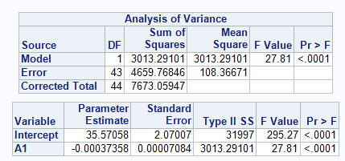
FIGURE 2.2: FITTING THE MODEL USING FORWARD SELECTION
Figure 2.2 shows this model is useful with P₀ < 0.005 and only variable A1 should be included in this model as it is significant at 5% level.

Slide 9
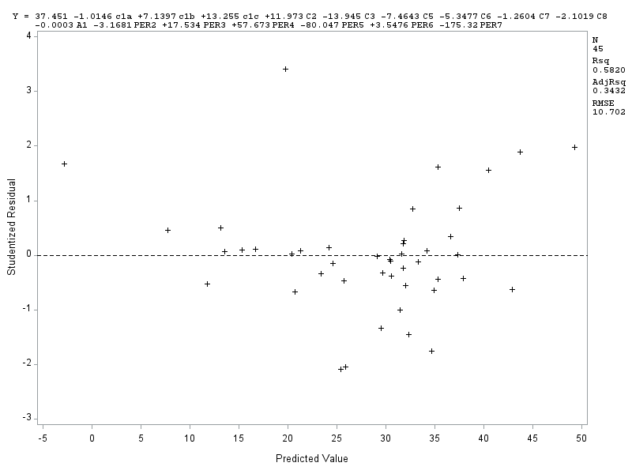
FIGURE 2.1: PLOT OF STUDENTIZED RESIDUALS AGAINST FITTED VALUES
The studentized residual do not appear to be reasonably randomly distributed about the mean value of zero with approximately irregular range (hence variance) across the entire range of fitted value. There is clearly an evidence of partial pattern in the plots. This is an evidence that this plot is not fully consistent with adequacy of the systematic component.

Slide 10
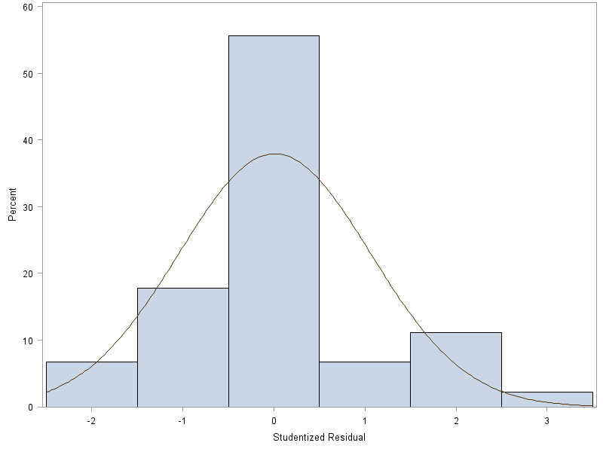
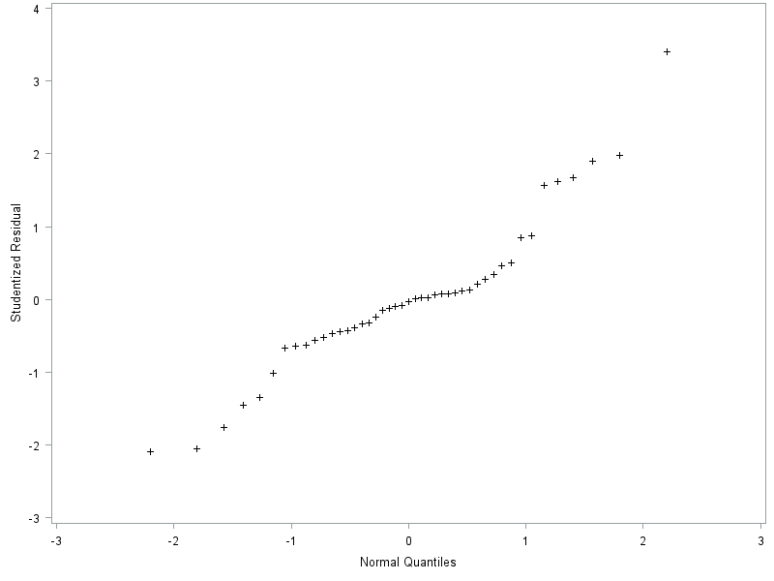
FIGURE 2.2: HISTOGRAM OF STUDENTIZED RESIDUALS
FIGURE 2.3: NORMAL PROBABILITY PLOT OF STUDENTIZED RESIDUALS.
Figure 2.2 above is based on 45 observations, so should be reasonably reliable. The histogram suggests that the residuals have a unimodal distribution but that they are positively skewed.
The normal probability plot for the studentized residuals partially conform to an approximate straight line of unit slope passing near the origin on the normal

Slide 11
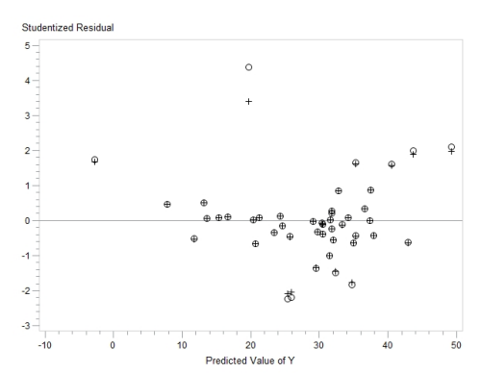
FIGURE 2.4: OVERLAID RESIDUAL PLOT
From the figure above the studentized and the deleted residuals are virtually identical, so they are mostly perfectly superimposed on the plot.
However the degree of separation is quite small for the circled points and only three falls outside the range of -2 to 2. These might be a potential outliers.

Slide 12
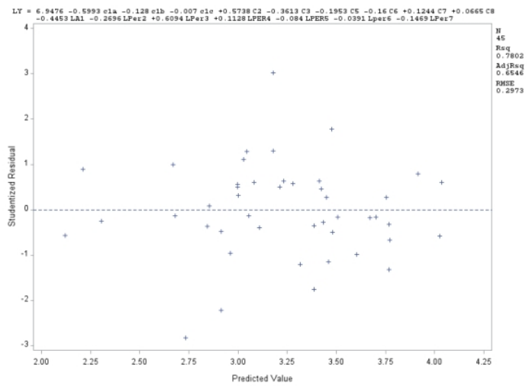
NB: it is not necessary to transform them c1 to c3 and c5 to c8 be categorical and binary variables. They are basically representation and do not have real numbers as their values. Taking the log of zero (0) for instance is undefined whist taking the log of 1 will yield zero. So definitely, transforming them will not improve the model.
FIGURE 3.1: PLOT OF STUDENTIZED RESIDUALS AGAINST FITTED VALUES FOR TRANSFORMED VARIABLE.
The studentized residual appears to be reasonably randomly scattered about the mean value of zero with approximate range across the entire range of fitted values unlike the plot untransformed dataset. The adjusted r-square however shoes that 65% of the variation is explained. we conclude that this plot is consistent with the adequacy of systematic component of the multiple regression, and with the assumption of constant variance.

Slide 13
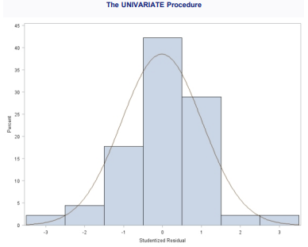
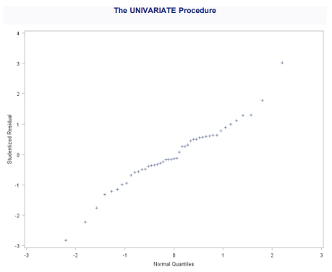
FIGURE 3.2: HISTOGRAM OF STUDENTIZED RESIDUALS
FIGURE 3.3: NORMAL PROBABILITY PLOT OF STUDENTIZED RESIDUALS FOR TRANSFORMED DATA
The histogram of residual is based in figure3.2 shows that the residual is normally distributed and unimodal.
In Figure3.3, studentized residuals for the pfarg data conform to an approximate straight line of unit slope passing near the origin on this normal. We conclude that this distribution satisfy near-normality assumption.

Slide 14
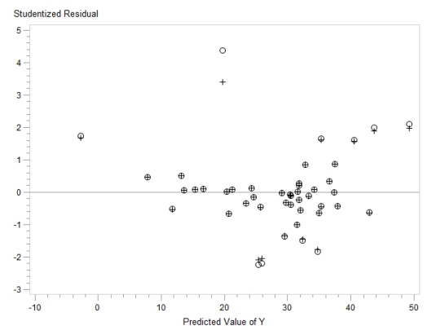
FIGURE 3.4: OVERLAID RESIDUAL PLOT
From the figure above the studentized and the deleted residuals are virtually identical, so they are mostly perfectly superimposed on the plot.
However the degree of separation is quite small for the circled points and only three falls outside the range of -2 to 2. These might be a potential outliers and should be investigated.
In general, transformation of pfarg dataset is consistent with the relevant key assumptions i.e homoscedasticity, near-normality, mutual independence and adequacy of systematic components unlike questions 2.

Slide 15
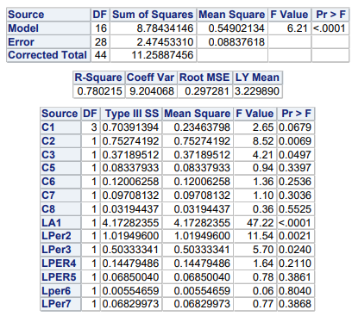
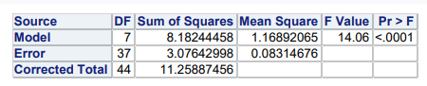
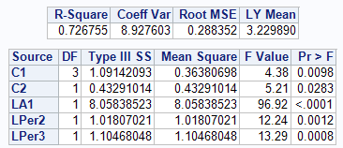
FIGURE 4.1: TYPE III TABLE BEFORE MODEL SELECTION.
FIGURE 4.2: TYPE III TABLE FOR THE SELECTED MODEL.
The model pr shows the model is useful. R-square explained 72% of the variation.
After non-significant explanatory variables and factors have been removed, Figure 4.2 show typeIII F tests for variables c1, c2, LA1, LPER2 and LPER3 have p-values below 0.05, so they are very highly significant and forms explanatory variables in the final model.
Figure 4.1 shows typeIII table of variables without selection. Explanatory term (factors or variable) with the largest associated non-significant p-value will be removed in each stage until we have a model in which all the explanatory term are significant.

Slide 16
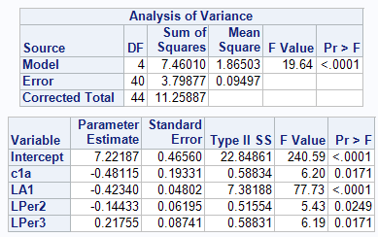
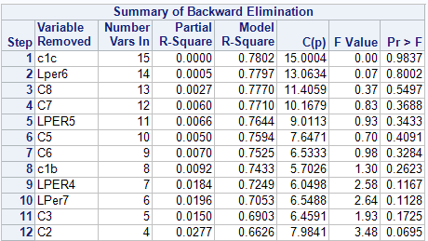
FIGURE 4.4:SUMMARY OF BACKWARD ELIMINATION
FIGURE 4.3: PARAMETER ESTIMATE
Figure 4.3 shows result of backward elimination, the reduced model containing only the surviving explanatory variable c1a LA1, LPER1, LPER2 and LPER3.
Figure 4.4 shows the order of the automatically removed variables, this is because they are not significant i.e their pr> 0.05.
Technically the model in figure 4.2 appears reasonably efficient to predict the response variable when compared to figure 4.3 LY because the result in automatic backward elimination removed some levels of C1 which seems inappropriate to predict LY. It is on this note I have decided to use the model in the in figure 4.2

Slide 17
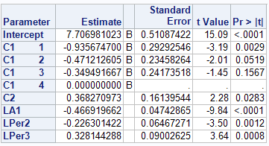
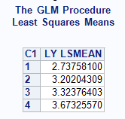
FIGURE 4.3: PARAMETER ESTIMATE AND LSMEAN TABLE
The explanatory variables c2 and Lper3 has parameter estimate of 0.368270873 and 0.328144288 respectively. Since this is positive, the model estimates that the total cost per active member will increase with number of pensioners per active member increases.
However, variables LA1 and LPER2 has parameter estimate of -0.466919662 and -0.226301422 respectively. This is obviously a negative relationship between the response variable y and the two explanatory variables. The model estimate that as the active members and number of deferred pensioners per active member increases total cost per active member decreases and vice-versa.
The final model will therefore consist of estimated intercept plus estimated adjustment depending on the level of funds type.

Slide 18
LY = β₀ + β₁ C1 + β₂C2 + β₃ LA1 + β₄ LPER2 + β₄LPER3
LY = 7.706981023 - 0.935674700 C1A – 0.471212605C1B – 0.349491667 C1C
+ 0.368270973C2 - 0.466919662 LA1 - 0.226301422LPER2 + 0.328144288LPER3{
If C1 = 1 then LY = 6.771306323 + 0.368270973C2 - 0.466919662 LA1 - 0.226301422LPER2 + 0.328144288LPER3
IF C1 = 2 then LY = 7.235768418 + 0.368270973C2 - 0.466919662 LA1 - 0.226301422LPER2 + 0.328144288LPER3
IF C1 = 3 THEN LY = 7.357489356 + 0.368270973C2 - 0.466919662 LA1 - 0.226301422LPER2 + 0.328144288LPER3
IF C1 = 4 THEN LY= 7.706981023 + 0.368270973C2 - 0.466919662 LA1 - 0.226301422LPER2 + 0.328144288LPER3
From the least square mean table, it is observed that level 4 has the highest mean. (combined scheme different scales)
With a coefficient of determination of R² = 0.726755, this model will provide very good predictions for
LY

Slide 19
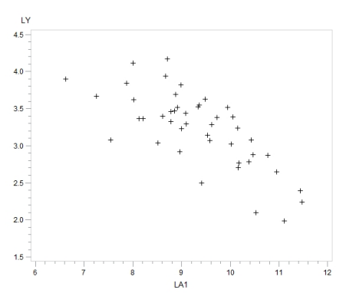
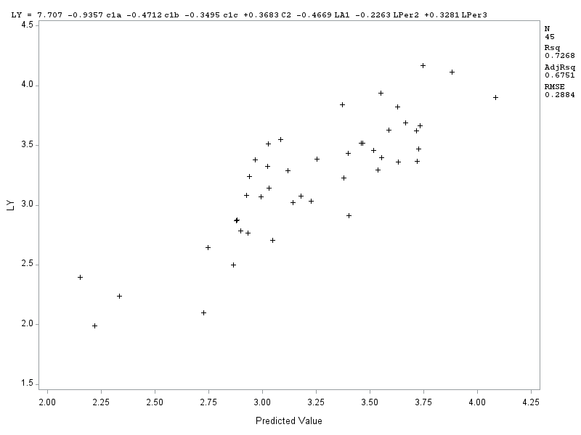
FIGURE 5.2: SCATTER DIAGRAM OF OBSERVED VERSUS PREDICTED OF LY
FIGURE 5.1: PLOT OF LY AGAINST FITTED VALUE OF THE FINAL MODEL
In figure 5.1: The multiple regression adequately describes the systematic variation present in the response ly across the entire range of predicted values as the observations appears to have linear relationship.
The scatter plot of LY(total cost per active member) in figure 5.2 show that the points appears relatively randomly distributed across the entire range of LA1 (active members) values. There seeems to be a little negative linear relationship between LY and LA1

Slide 20
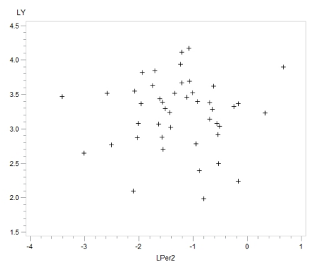
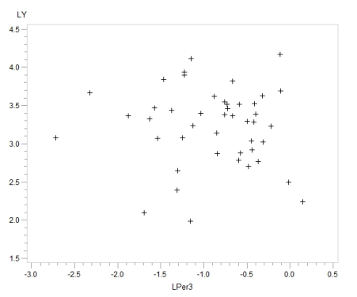
FIGURE 5.3: SCATTER PLOT OF LY AGAINST LPER2
FIGURE 5.4: SCATTER PLOT OF LY AGAINST LPER3
In FIGURE 5.3 the scatterplot of LY and LPER2, the observation look randomly distributed with no stong linear relationship
Figure 5.4 is show no relationship between LY and variable LPER2. The points are randomly scattered.

Slide 21
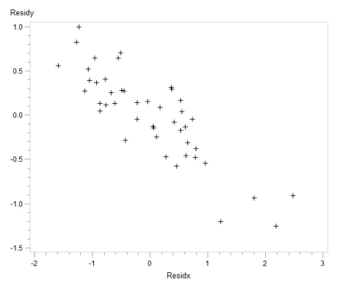
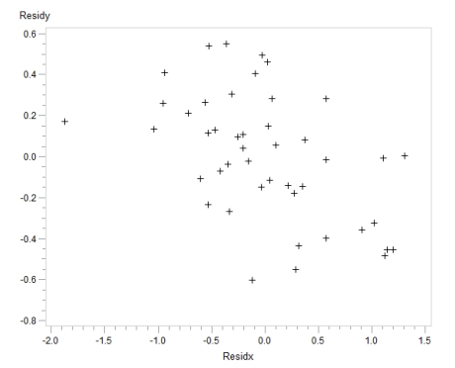
FIGURE 5.5 ADDED VARIABLE PLOT FOR A1
FIGURE 5.6 ADDED VARIABLE PLOT FOR LPER2
Figure 5.5 has negative relationship with
LY just like figure 5.2
The points are randomly scattered, no evidence of relationships between y and LPER1 variables

Slide 22
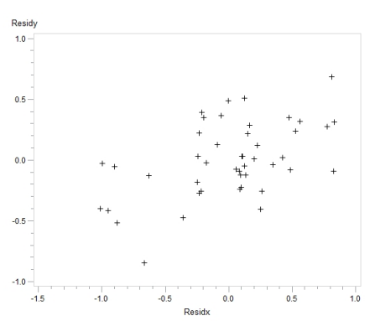
FIGURE 5.7: ADDED VARIABLE PLOT FOR LPER3 (RESPONSE IS LY)
Little positive linear relationship exist between
LPER3 and LY.

Slide 23
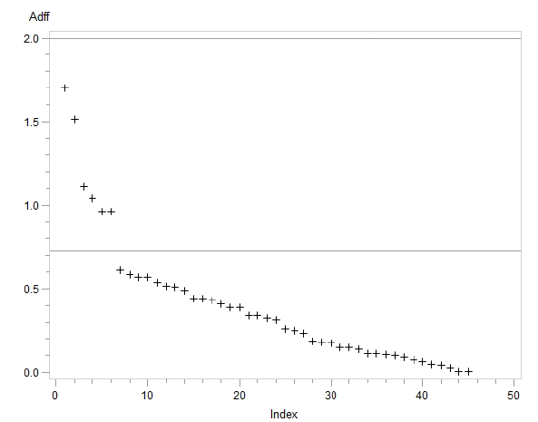
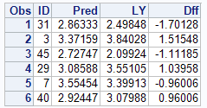
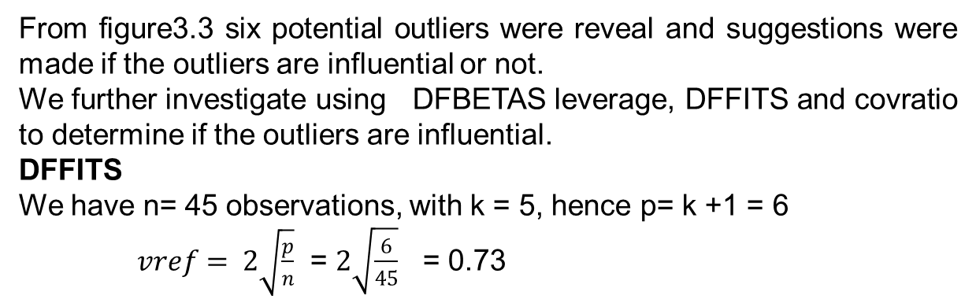
From figure3.3 six potential outliers were reveal and suggestions were made if the outliers are influential or not.
We further investigate using DFBETAS leverage, DFFITS and covratio to determine if the outliers are influential.
DFFITS
We have n= 45 observations, with k = 5, hence p= k +1 = 6
$vref= 2\sqrt{\frac{p}{n}}$ = $2\sqrt{\frac{6}{45}}$ = 0.73
FIGURE 6.1: ABSOLUTE DFFITS VALUES IN DESCENDING ORDER
FIGURE6.2: FURTHER INVESTIGATION OF THE OUTLIERS
Figure 6.2 further reveal the potential influential observations to be those with ID 31, 3, 45, 29, 7 and 40.
The six potential influential are below with their fitted and observed values:
(2.86333, 2.49848), (3.37159, 3.84028), (2.72747, 2.09924), (3.08588, 3.55105), (3.55454, 3.39913), (2.92447, 3.07988).
From figure 6.1, It is obvious that two point on the graph stands out. However the leftmost 6 points all have an absolute DFFITS value above the size-related cut-off, although no absolute DFFITS value exceed the overall cut-off. The six point above the minimum cut off will further be investigated

Slide 24
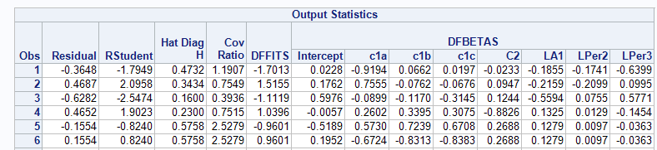
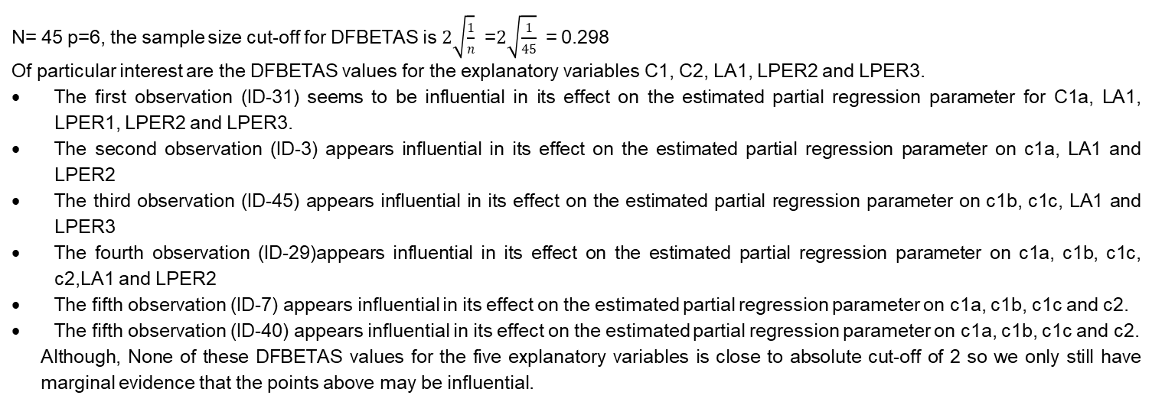
DFBTAS
FIGURE 6.3: OUTPUT STATISTIC TABLE
N= 45 p=6, the sample size cut-off for DFBETAS is $2\sqrt{\frac{1}{n}}$ =$2\sqrt{\frac{1}{45}}$ = 0.298
Of particular interest are the DFBETAS values for the explanatory variables C1, C2, LA1, LPER2 and LPER3.
The first observation (ID-31) seems to be influential in its effect on the estimated partial regression parameter for C1a, LA1, LPER1, LPER2 and LPER3.
The second observation (ID-3) appears influential in its effect on the estimated partial regression parameter on c1a, LA1 and LPER2
The third observation (ID-45) appears influential in its effect on the estimated partial regression parameter on c1b, c1c, LA1 and LPER3
The fourth observation (ID-29)appears influential in its effect on the estimated partial regression parameter on c1a, c1b, c1c, c2,LA1 and LPER2
The fifth observation (ID-7) appears influential in its effect on the estimated partial regression parameter on c1a, c1b, c1c and c2.
The fifth observation (ID-40) appears influential in its effect on the estimated partial regression parameter on c1a, c1b, c1c and c2.
Although, None of these DFBETAS values for the five explanatory variables is close to absolute cut-off of 2 so we only still have marginal evidence that the points above may be influential.

Slide 25
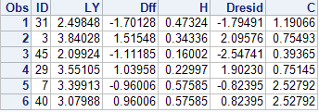
FIGURE 6.3: COVRATIO, LEVERAGE AND DELETED RESIDUAL TABLE
Recall that n= 45 and p =6, the leverage (H) therefore have average p/n = 6/45 = 0.133 cut-off value 3p/n = 15/45 = 0.40
The corresponding limits for C (COVRATIO) are therefore 1±3p/n = 0.6 and 1.4 respectively.
The observation for ID-31 has a high leverage (above the cut-off) and moderately large deleted residual (but still with an absolute value below 2), the covariance ratio (C) is within the accepted limit but above 1, this indicate the inclusion of this observation has effect on the precision of the fitted multiple regression equation. Therefore the point causes concern.
The observation ID-3 has a moderately above average and a very high large deleted residual which is above the cut-off (above the cut-off of 2), the covratio is within the accepted limit and its value is close to1. This point cause a concern and must be investigated.
The observation 3 (ID-45) has a moderate leverage, but extremely high deleted residual with a covratio below the the cut-off limit. This indicate the inclusion of this observation has effect on the precision of the fitted multiple regression equation,. On further investigation, this point also cause concern
The observation 4 (ID-29) has moderate leverage, moderately large deleted residual (but still with an absolute value below 2), and covratio is within the cut-off limit. The inclusion of this may slight improve the precision of the fitted multiple regression equation.
The observation 5 (ID-7) has very high leverage, moderate deleted residual (but still with an absolute value below 2), and covratio is above the cut-off limit. The inclusion of this have effects on the precision of the fitted multiple regression equation.
The observation 6 (ID-29) has very high leverage, moderate deleted residual (but still with an absolute value below 2), and covratio is above the cut-off limit. The inclusion of this have effects on the precision of the fitted multiple regression equation. On further investigation, this point may cause little concern.

Slide 26
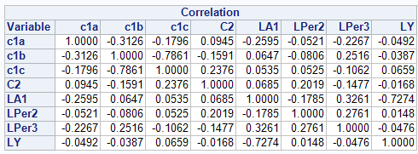
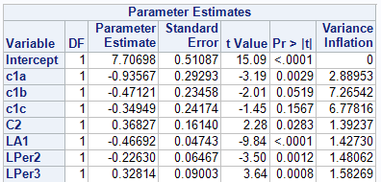
FIGURE 6.4: CORRELATIONAL METRIX
Most of the correlations in the above FIGURE 6.4 are too low to be of much interest (0.5) cut-off. Among the higher absolute correlations (that may indicate high relationship) are those between c1c and c1b (0.7861).
FIGURE 6.5: VARIANCE INFLATION FACTOR TABLE (VIF)
No VIF approaches the cut-off point of 10, so none of the potential explanatory variables can particularly well predicted by its fellow explanatory variables. There is little or no evidence to suggest that collinearity exist among the potential explanatory variables for this regression.

Slide 27
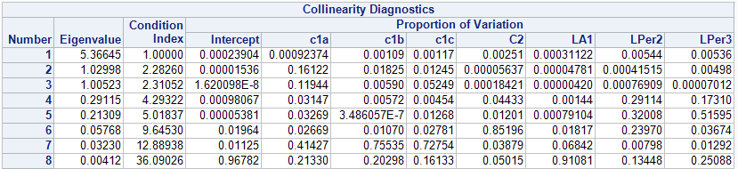
FIGURE6.5: COLLINEARITY DIAGNOSTIC TABLE
In row number 8, the variables LA1 (0.91081) clearly have highest loading. LPER2 (0.13448) and LPER3 (0.25088) have slightly high loadings. Variables LA1, LPER2 and LPER3 are highly linearly related to each other.

Slide 28
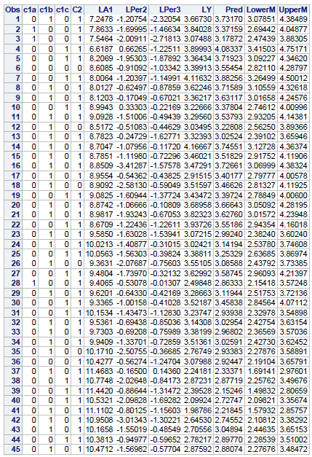
FIGURE7.1: CONFIDENCE LIMIT TABLE
Clearly, none of the Observation is above the or below the total cost per active members. The predicted and the fitted values are very close and both are within the intervals in all the observations.
This information would be of interest for the pension managers who participated in this investigation. For each manager, the variable pred gives the best prediction of the total administrative costs of pension funds per active member.
The 95% confidence limit for the underlying mean allow each manager to determine whether the administrative cost is in line with every other.
A pred value below the lower limit would be cause for some satisfaction, while a pred value above the upper limit would be cause for concern.

